Slide 1


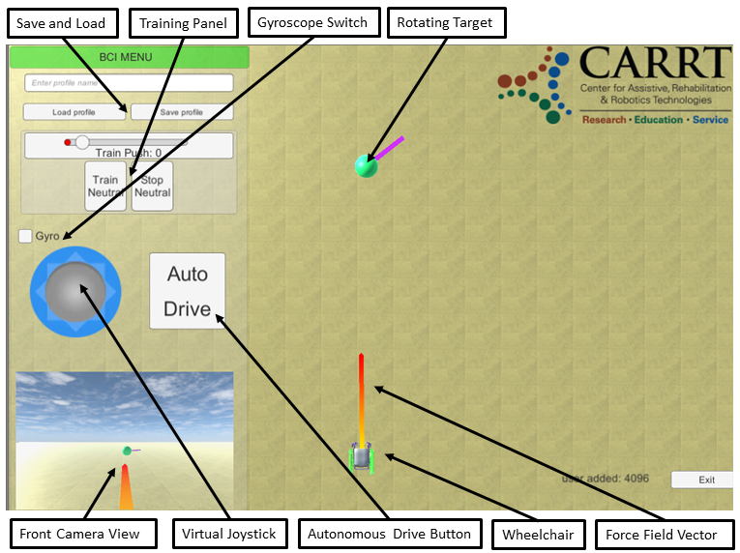

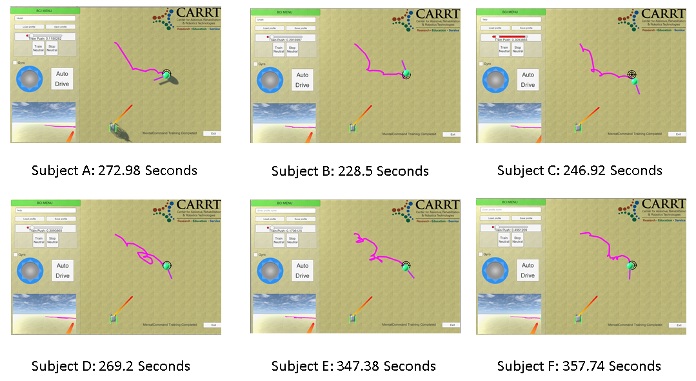
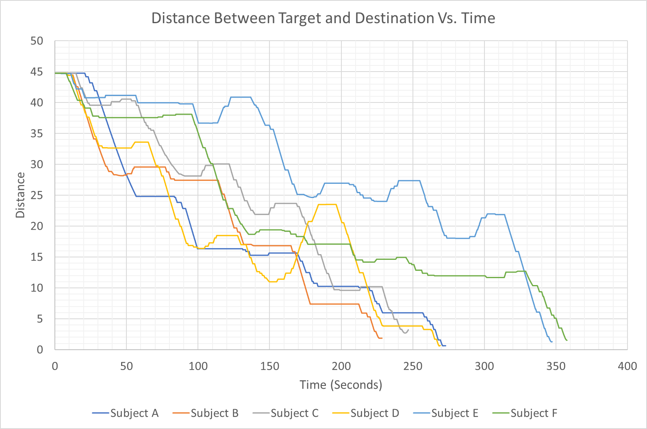
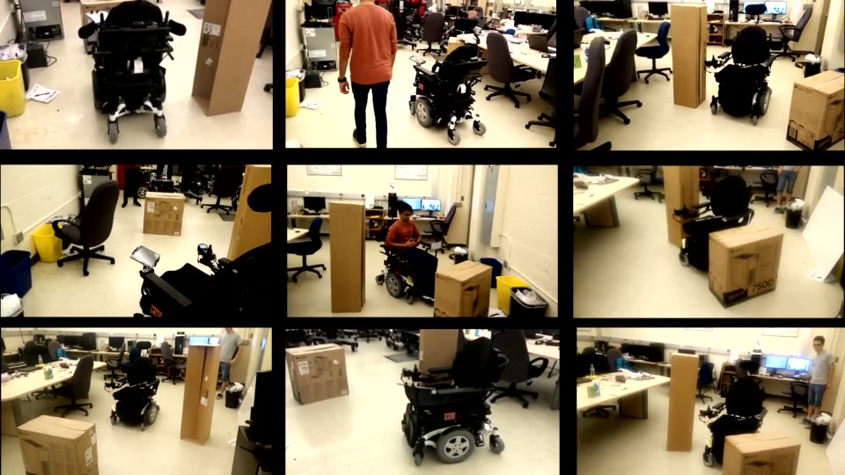
BCI-Controlled Hands-Free Wheelchair with Obstacle Avoidance
R. Mounir, R. Alqasemi Ph.D, R. Dubey Ph.D
Department of Mechanical Engineering
Introduction
System Design
Graphical User Interface
Brain-Computer interfaces (BCI) are widely used in reading brain signals and converting them into real-world motion. However, the signals produced from the BCI are noisy and hard to analyze. This project looks specifically towards combining the BCI’s latest technology with ultrasonic sensors to provide a hands-free wheelchair that can efficiently navigate through crowded environments. The sensors provide safety and obstacle avoidance features necessary for the BCI Navigation system to gain more confidence and operate the wheelchair at a relatively higher velocity than without the Ultrasonic Sensors (Mobility Assistance).
This project combines two separate tasks; controlling the target destination with the BCI device, and autonomous navigation of the wheelchair to the BCI-controlled target while avoiding obstacles. A tablet is used to communicate with the Joystick, encoders and sensors modules through Bluetooth. The tablet runs all the navigation algorithms and displays the following:
The Real time position and orientation of the wheelchair, obstacles and target.
BCI command training and execution panel.
Virtual Joystick, autonomous drive button and Gyroscope switch to navigate the wheelchair using Gyroscope.
Figure 1: GUI presented on the tablet
Obstacle Avoidance
Potential Field algorithm is utilized using Eight sensors (four on each side) to detect obstacles.
Obstacles generate a repulsive force, while the target generates an attraction force. Forces’ strengths can be tuned by users, if needed.
The net force navigates the wheelchair autonomously through a PID controller (figure 2).
Brain-Computer Interface
Six subjects were trained for 10 minutes and asked to move the target to a predefined position (figure 3).
Subjects successfully moved the target to the destination in an average of 287 seconds (figure 4).
One mental command is used to move the target in 2D space.
As the target rotates, the user triggers a mental command in the intended direction.
Figure 3: BCI testing with motion trail
Figure 2: Obstacle Avoidance Testing environment
Figure 4: BCI Testing: Distance Vs Time
Conclusion & Future Work
References
All human subjects were able to control the target destination using merely brain (EEG) signals utilizing motor imagery BCI control.
The wheelchair successfully navigates all obstacles, using the potential field algorithm, and safely reaches the target destination.
A more sophisticated motion planning algorithm can be implemented to avoid local minima.
Fine tuning of the potential field algorithm hyperparameters is necessary for better obstacle avoidance performance.
Ashley, D., Ashley, K., Alqasemi, R., & Dubey, R. (2017, July). Semi-autonomous mobility assistance for power wheelchair users navigating crowded environments. In Rehabilitation Robotics (ICORR), 2017 International Conference on (pp. 1025-1030). IEEE.
Roy, R. N., Bonnet, S., Charbonnier, S., & Campagne, A. (2013, July). Mental fatigue and working memory load estimation: interaction and implications for EEG-based passive BCI. In Engineering in Medicine and Biology Society (EMBC), 2013 35th Annual International Conference of the IEEE (pp. 6607-6610). IEEE.
K. Stamps and Y. Hamam, “Towards Inexpensive BCI Control for Wheelchair Navigation in the Enabled Environment – A Hardware Survey,” Brain Informatics Lecture Notes in Computer Science, pp. 336–345, 2010.
BCI-Controlled Wheelchair : Obstacle Avoidance Demo, 30-Jul-2018. [Online]. Available: https://www.youtube.com/watch?v=cZN2oBABRjQ.
Carlson, T., & Millan, J. D. R. (2013). Brain-controlled wheelchairs: a robotic architecture. IEEE Robotics & Automation Magazine, 20(1), 65-73.
Acknowledgement
The authors would like to thank the Florida Department of Education - Division of Vocational Rehabilitation for their support.

